Slide 1
Credit Card Users Churn Prediction Project

Slide 2
Content:
Business Problem and overview
Data Overview
Exploratory Data Analysis
Model creating and Performance Analysis
Comparison of Model Performance and Summary
Business Insights and Recommendation

Slide 3
Context:
Thera Bank recently saw a steep decline in the number of users of their credit card.
credit cards are a good source of income for banks because of different kinds of fees charged by the banks like annual fees, balance transfer fees, and cash advance fees, late payment fees, foreign transaction fees, and others. Some fees are charged to every user irrespective of usage, while others are charged under specified circumstances.
Customers’ leaving credit cards services would lead the bank to loss.
Objective:
To identify and predict customers who will cancel their Credit Card Services.
To find the possible reasons for the cancellation
Find Important and significant features of the Customers to target

Slide 4
Business Solution:
We will build Base models : Logistic Regression, Decision Tree, Random Forest , Bagging and Boosting Classifiers to predict and identify potential customers who will cancel their card service
We will then choose the three most optimal models based on Performance Scores and Hypertune them using GridSearchCV and RandomSearchCV methods and find the best model with the most suitable performance scores
Key Questions:
What key variables are important in identifying customers who will cancel their service?
Which metric is right for model performance evaluation and why?

Slide 5
Data Information:
Variable | Description
CLIENTNUM | Client Number which is unique per customer
Attrition_Flag | If account closed – Attrited Customer; else : Existing Customer
Customer_Age | Age in Years
Gender | Gender of the Customer
Dependent_Count | Number of Dependents
Education_Level | Education Qualification of Customer
Marital_Status | Marital Status of account holder
Income_Category | Annual Income Category of account holder
Card_Category | Type of Card
Months_on_book | Period of relationship with the bank
Total_Relationship_Count | Total No of products held by the customer

Slide 6
Variable | Description
Months_Inactive_12_mon | No of Months inactive in the last 12 months
Contacts_Count_12_mon | No of Contacts between the customer and bank in the last 12 months
Credit_Limit | Credit Limit on the Credit Card
Total_Revolving_Bal | Balance carried over from one month to the next
Avg_Open_To_Buy | Refers to the amount left on the credit card to use (Avg 12 months)
Total_Trans_Amt | Total Transaction Amount (Last 12 months)
Total_Trans_Ct | Total Transaction Count (Last 12 months)
Total_Ct_Chng_Q4_Q1 | Ratio of total transaction count in 4th quarter to 1st quarter
Total_Amt_Chng_Q4_Q1 | Ratio of total transaction count in 4th quarter to 1st quarter
Avg_Utilization_Ratio | Represents how much available credit the customer spent

Slide 7
Data Overview
There are total of 10127 observations of data across 21 variables, with 15 Numerical and 6 Object Datatype.
Data Manipulation:
The Dependent Variable Attrition_Flag was converted to category from object datatype
Similarly, all object datatype variables were also converted to Categorical datatype.
Dependent_Count variable was also converted to Category as it represented the number of Dependents(i.e people) of the main account holder
CLIENTNUM variable was dropped from model analysis as it added no value.
Several Numerical variables had Outliers in the higher end. However, this was not treated as we want the model to understand such scenarios and predict patterns
Marital_Status, Education_Level and Income_Category had an ‘Unknown’ category which was later considered as missing values. Then the missing values were later imputed using KNN Imputer.

Slide 8
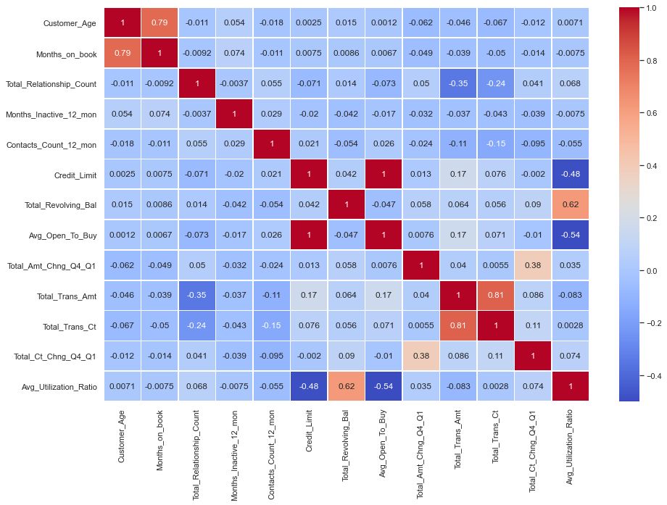
Exploratory Data Analysis : Correlation Matrix

Slide 9
Observations:
Variables with Higher Positive Correlation:
Customer_Age and Months_on_Book
Total_Trans_Amt and Total_Trans_Ct
Avg_Utilization_Ratio and Total_Revolving_Bal
Variables with Moderate to low Positive Correlation:
Total_Ct_Chng_Q4_Q1 and Total_Amt_Chng_Q4_Q1
Credit_Limit and Total_Trans_Amt
Variables with Higher Negative Correlation:
Avg_Utilization_Ratio and Avg_Open_To_Buy
Avg_Utilization_Ratio and Credit_Limit
Variables with Moderate to Low Negative Correlation:
Total_Relationship_Count with both Total_Trans_Amt and Total_Trans_Ct
Contacts_Count_12_mon also with both Total_Trans_Amt and Total_Trans_Ct

Slide 10
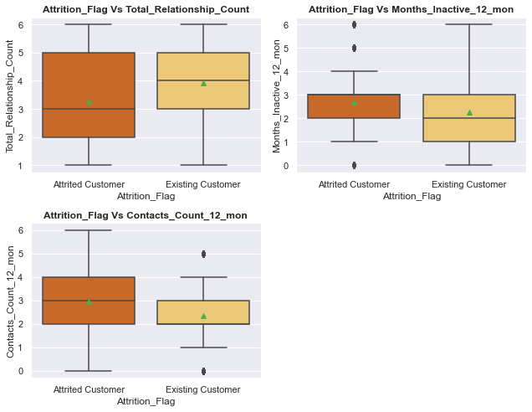
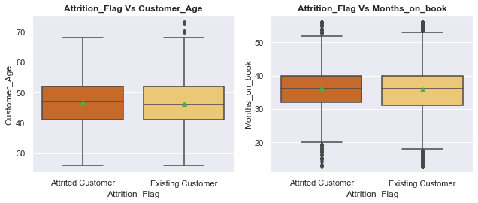
Bi-variate Data Analysis:
To study the distribution and Dispersion of each variables and their relationship with the dependent variable
Numerical Columns with Dependent Variable (Attrition_Flag)
Observations:
The Attrition is higher among customers who have more products with the bank.
50% of customers who were inactive for 3 months have closed the card
The number of contacts with the banks among Attrited customers is higher than Existing Customers.
The median values for both Attrited and Existing Customers is almost equal in both Customer_Age and Months_on_book variables.

Slide 11
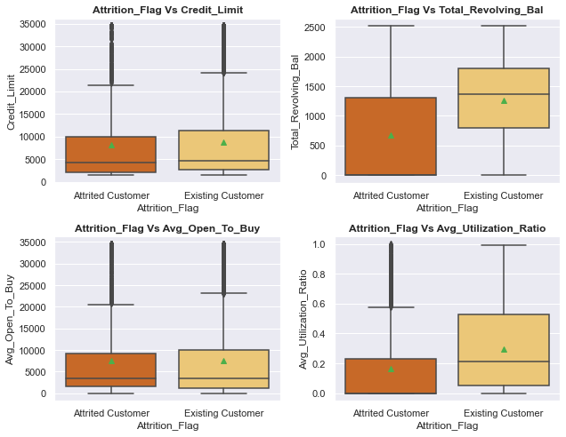
Observations:
Mean Credit_Limit for both Attrited and Existing customers is almost equal with several outliers in the higher end for both.
More customers with Zero or comparatively low Revolving Balance have also closed their account

Slide 12
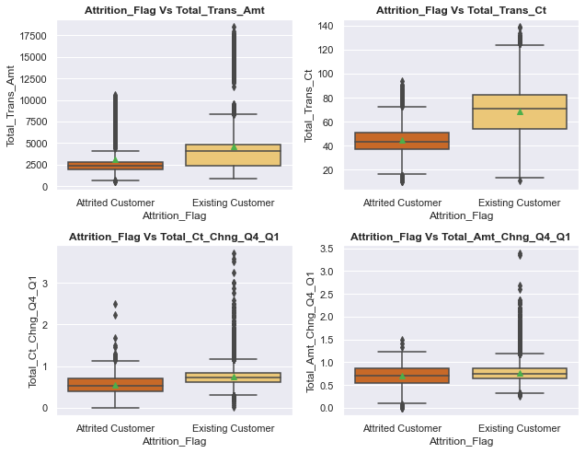
Observations:
The median Total_Trans_Amt for Attrited Customers is almost 50% less than median Amount for Existing Customers.
Similarly, the median value for Total_Trans_Ct is also very low compared to Exisitng Customers
This suggests that Customers who have low - reduced Card usage attrite.
Both Total_Amt_Chng_Q4_Q1 and Total_Ct_Chng_Q4_Q1 have mean values less than 1, for Attrited Customers. This could suggest that the Customer Card usage decreased in Q4 compared to Q1.

Slide 13
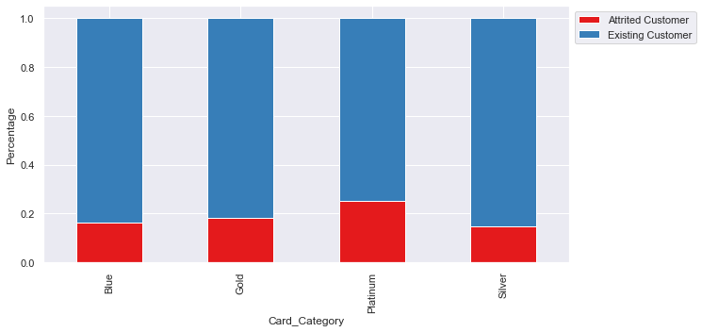
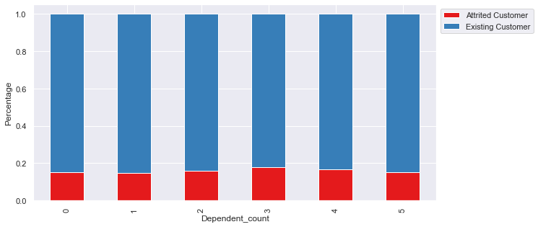
Categorical Columns with Dependent Variable (Attrition_Flag)
Observations:
The percentage of Attrited Customers is almost equal across 0,1,4 & 5 dependent counts
We see a very slight rise in Customers with 2 and 3 dependents.
Customers with Platinum Cards see slight higher Attrition than customers with other card types..

Slide 14
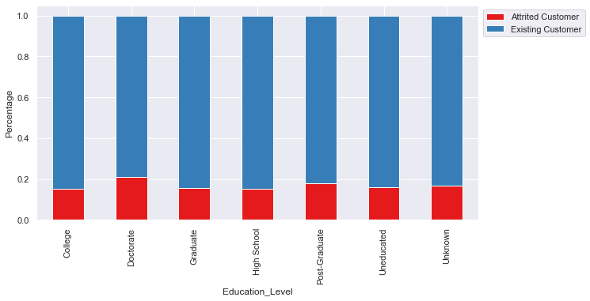
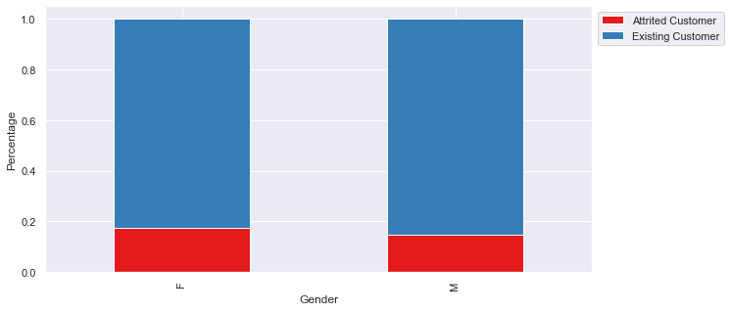
Categorical Columns with Dependent Variable (Attrition_Flag)
Observations:
The Attrition level is fairly consistent across all Education_Level except Doctorate, which is slightly higher at approx ~20%.
We see that there are slightly more Attrited Female customers than Male customers. This could be because we have more Female customers in this dataset

Slide 15
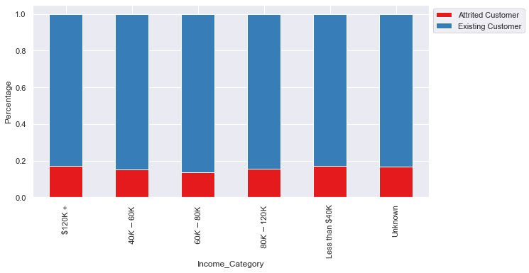
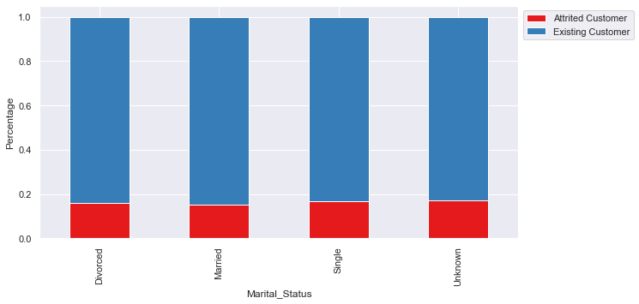
Categorical Columns with Dependent Variable (Attrition_Flag)
Observations:
Here too we see that the Attrition Percentage is almost equal across all Marital_Status categories.
Married and Single Customers make about 85% of the Customer base, and still have equal Attrition compared to Divorced and Unknown categories
The percentage of Attrited_Customers is almost the same across all Income_Category

Slide 16
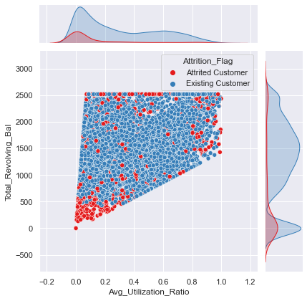
Multivariate Analysis Variables:
Total_Revolving_Bal Vs Avg_Utilization_Ratio Vs Attrition_Flag
Observations:
Attrition is higher on Customer with less than 0.2 Avg_Utilization_Ratio and lower Revolving_Bal values

Slide 17
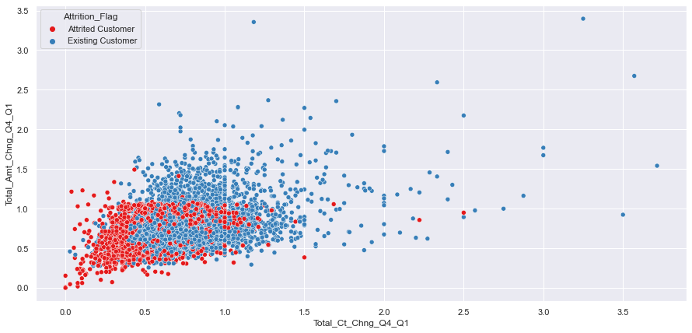
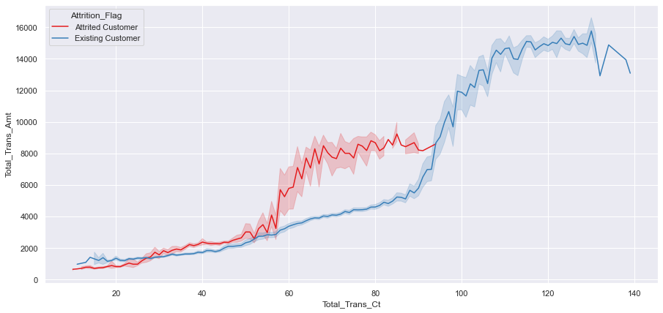
Multivariate Analysis Variables:
Total_Amt_Chng_Q4_Q1 Vs Total_Ct_Chng_Q4_Q1 Vs Attrition_Flag
Total_Trans_Amt Vs Total_Trans_Ct Vs Attrition_Flag
Observations:
For most Attrited Customers, the Total amount ratio and Total count ratio is less than 1.0.
This suggests a possibility that these customers have reduced card usage in the last three months of the year.
Observations:
Customers with Transaction Amount less than $10,000 and Transaction count less than 100 per year are more likely to cancel their Credit Card services.

Slide 18
Model Building - Overview
Model Evaluation Criteria:
Model can make two kinds of wrong predictions:
1.Predicting that a customer will cancel their Credit Card services but doesn’t : False Positive
2. Predicting that a customer wont cancel their Credit Card service but does : False Negative
The Bank's objective is to identify all potential Customer's who wish to close their Credit Card Services.
Incorrectly predicting Attrited Customers as Existing, will lead to loss for the bank
Hence the False Negative values must be reduced
How to reduce losses:
Recall is the Performance metric that must be improved.
The Recall score must be maximized and greater the score the less the chance of missing customers who will attrite

Slide 19
Comparison of all Models
Model | Total Time | Train_Accuracy | Test_Accuracy | Train_Recall | Test_Recall | Train_Precision | Test_Precision
ADA_Boost-GridSearchCV | 2min56s | 0.984340 | 0.966436 | 0.938543 | 0.877049 | 0.963063 | 0.910638
Gradient_Boost-Randomized SearchCV | 1min4s | 0.993087 | 0.970056 | 0.971027 | 0.877049 | 0.985740 | 0.932462
Gradient_Boost-GridSearchCV | 6min26s | 0.992946 | 0.967753 | 0.972783 | 0.872951 | 0.983141 | 0.922078
XG_Boost-GridSearchCV | 18min53s | 0.999859 | 0.969069 | 0.999122 | 0.870902 | 1.000000 | 0.932018
ADA_Boost-RandomizedSearchCV | 1min39s | 0.980389 | 0.965449 | 0.923617 | 0.866803 | 0.952899 | 0.913607
XG_Boost-RandomizedSearchCV | 4min3s | 0.998448 | 0.968740 | 0.992098 | 0.864754 | 0.998233 | 0.935698

Slide 20
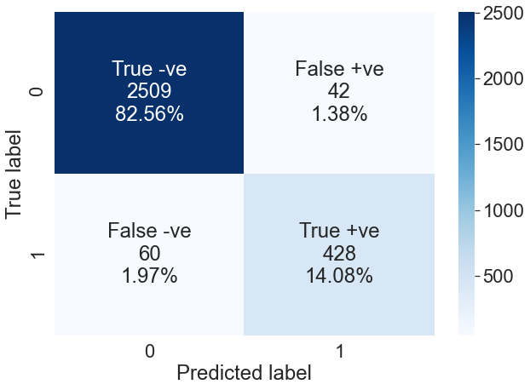
Confusion Matrix of ADA Boost GridSearch CV
Conclusion:
From the above table we see that `ADA_Boost-GridSearchCV` has the highest Recall Score of 0.877
* The Model also an overall generalized performance scores with slight overfit issues in Recall and Precision.
Nevertheless, we will choose this model as the best fit model for the dataset
The True Positive values is at 14.08% and the False Negative values are quite low at 1.97%.
Let's see the important features for this model.

Slide 21
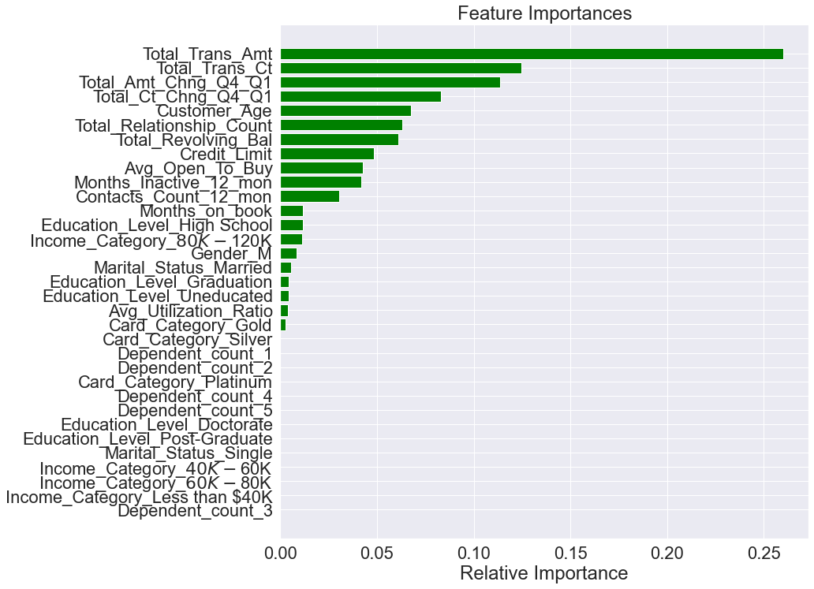
Feature Importance – ADA Boost GridSearch CV
The most important features with
relative importance greater than
0.1 are:
Total_Trans_Amt
Total_Trans_Ct
Total_Amt_Chng_Q4_Q1
Subsequent features of relative importance:
Total_Ct_Chng_Q4_Q1
Customer_Age
Total_Relationship_Count
Total_Revolving_Bal

Slide 22
Business Insights
Total_Transaction_Amt is the most important variable that indentifies a possible attriting customers
Form our analysis, it shows that Customer who tend to have reduced or lower transactions in a year tend to cancel their card service.
Since Transaction_Count and Amount are directly correlated, the Bank can target customers who begin to see reduced card usage as months progress.
Another key finding is that such customers tend to have low card usage in the 4th quarter(Oct-Nov-Dec months) of the year.
The Bank must investigate and target such customers by providing incentives and offers to ensure their card usage doesnt drop. The Bank can also offer additional deals per the customer's requirement to increase retention.

Slide 23
The Bank must also monitor Customers betwee ages 40 -55 yrs and those with more than 3 months of Inactivity and investigate the reason behind the lack of usage and suggest improvements if any.
We also saw from our analysis that Customers with more products with the bank and those who contacted the bank often are at risk of Attrition. This suggest possible inefficiency in the quality of the Bank's services that needs to be addressed.
We have no information about the various Card Types and its benefits. From our analysis, we saw that the Blue Card was the most popular. We don’t have any further information to investigate on this occurrence.
More data on this category can help build Customer profiles for each card type thereby proving more insights.

Slide 24
Thank you

